Slide 1
EEE 342/ETE418
Control Engineering
Fall 2019
Lecture # 05
22 October 2019

Slide 2



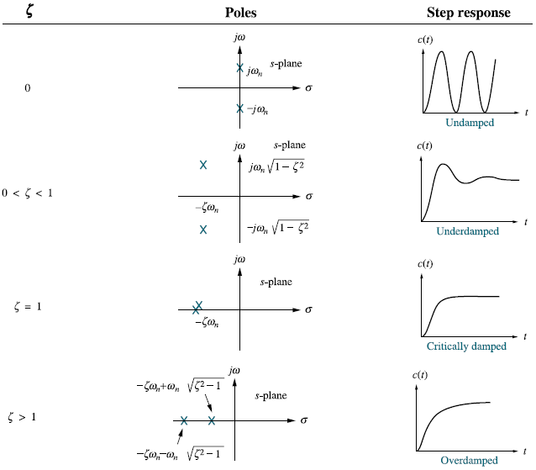

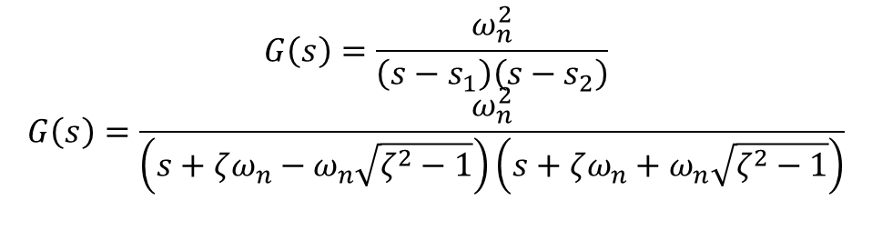
The General Second-Order System
$$G\left(s\right)=\frac{ω_{n}^{2}}{\left(s−s_{1}\right)\left(s−s_{2}\right)}$$
$$G\left(s\right)=\frac{ω_{n}^{2}}{\left(s+ζω_{n}−ω_{n}\sqrt{ζ^{2}−1}\right)\left(s+ζω_{n}+ω_{n}\sqrt{ζ^{2}−1}\right)}$$

Slide 3
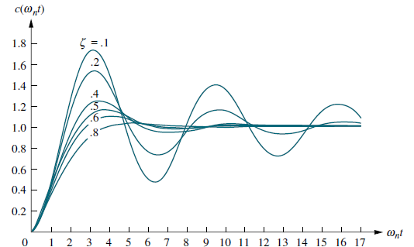
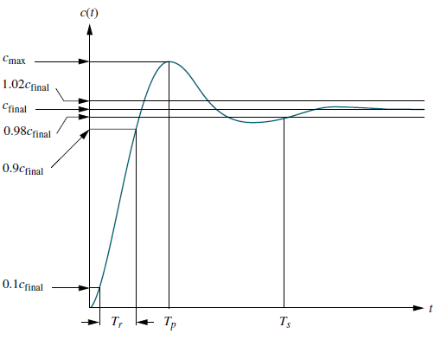


Underdamped
$$ℒ\left[\dot{c}\left(t\right)\right]=sC\left(s\right)=0$$
Rise time, TR
Peak time, TP
Percent overshoot, %OS
Settling time, TS

Slide 4

Underdamped
Evaluation of %OS
Evaluation of Ts
In order to find the settling time, we must find the time for which c(t) in Eq. (4.28) reaches and stays within 2% of the steady-state value, cfinal.
Evaluation of Tr
Rise time, TR
Peak time, TP
Percent overshoot, %OS
Settling time, TS

Slide 5
